Slide 1
ST. VINCENT PALLOTTI COLLEGE OF ENGINEERING & TECHNOLOGY, NAGPUR
DEPARTMENT OF ELECTRONICS & TELECOMMUNICATION ENGINEERING
BEETE701T: DSP PROCESSOR & ARCHITECTURE
Instructor :M N Kapse
Email: mkapse@stvincentngp.edu.in

Slide 2
To study Programmable DSP Processors.
To provide an understanding of the fundamentals of DSP techniques.
To study implementation & applications of DSP techniques.
To study multi-rate filters.
To understand architecture of DSP processor.
Object
ives

Slide 3
Outcome:
By the end of this course, the students shall be able to ,
to describe the detailed architecture, addressing mode, instruction sets of TMS320C5X
to write program of DSP processor.
to design & implement DSP algorithm using code composer studio
to design decimation filter and interpolation filter.

Slide 4
Course Syllabus
Unit – I : FUNDAMENTALS OF PROGRAMMABLE DSPs
Unit - II : ARCHITECTURE OF TMS320C5X
Unit - III : PROGRAMMING TMS320C5X
Unit - IV : PROGRAMMABLE DIGITAL SIGNAL PROCESSORS
Unit – V : ADVANCED PROCESSORS
Unit – VI : IMPLEMENTATION OF BASIC DSP ALGORITHMS

Slide 5
UNIT 1 : FUNDAMENTALS OF PROGRAMMABLE DSPs
Multiplier and Multiplier accumulator
Modified Bus Structures and Memory access in P-DSPs
Multiple access memory
Multi-ported memory.
VLIW architecture, Pipelining, Special Addressing modes in PDSPs
On chip Peripherals
Computational accuracy in DSP processor
Von Neumann and Harvard Architecture, MAC

Slide 6
UNIT 2 : ARCHITECTURE OF TMS320C5X
Architecture
Bus Structure & memory
CPU
Addressing modes
AL syntax

Slide 7
UNIT 3 : Programming TMS320C5X
Assembly language Instructions
Simple ALP – Pipeline structure
Operation Block Diagram of DSP starter kit
Application Programs for processing real time signals.

Slide 8
UNIT 4 : PROGRAMMABLE DIGITAL SIGNAL PROCESSORS
Data Addressing modes of TMS320C54XX DSPs
Data Addressing modes of TMS320C54XX Processors
Program Control
On-chip peripheral
Interrupts of TMS320C54XX processors
Pipeline Operation of TMS320C54XX Processors
Block diagrams of internal Hardware, buses , internal memory organization.

Slide 9
UNIT 5: ADVANCED PROCESSORS
Code Composer studio
Architecture of TMS320C6X
Architecture of Motorola DSP563XX
Comparison of the features of DSP family processors

Slide 10
UNIT 6: IMPLEMENTATION OF BASIC DSP ALGORITHMS
Study of time complexity of DFT and FFT algorithm
Use of FFT for filtering long data sequence
Interpolation filter
Decimation filter
Wavelet filter

Slide 11
T e x t B o o k s
1. B. Venkata Ramani and M. Bhaskar, Digital Signal Processors, Architecture, Programming and TMH,2004.
2. Avtar Singh, S.Srinivasan DSP Implementation using DSP microprocessor with Examples fromTMS32C54XX -Thamson 2004.
3. E. C. Ifeachor and B.W Jervis, Digital Signal Processing - A Practical approach, Pearson Publication
4. Salivahanan. Gyanapriya, Digital signal processing, TMH , Second Edition

Slide 12
Re f erence Books
1. DSP Processor Fundamentals, Architectures & Features – Lapsley et al. , S. Chand & Co, 2000.
2. Digital signal processing-Jonathen Stein John Wiley 2005.
3. S.K. Mitra, Digital Signal Processing, Tata McGraw-Hill Publication, 2001.
4. B. Venkataramani, M. Bhaskar, Digital Signal Processors, McGraw Hill

Slide 13
Online References
https://www.ti.com/
…………..lit/ug/spru056d/spru056d.pdf
https://www.bdti.com/Resources/Comp.DSP.FAQ/Part3
………….Comp.DSP FAQ: Berkeley Design Technology, Inc
http://users.ece.utexas.edu/~bevans/courses/realtime/index.html
………………..EE445S Real-Time Digital Signal Processing Laboratory
http://dspfirst.gatech.edu/matlab/
………………Educational Matlab GUIs
http://dspfirst.gatech.edu/

Slide 14

Useful
https://youtu.be/82pYzfP7Plc .. What is a DSP? Why you need a Digital Signal Processor for Car Audio
https://youtu.be/hDR4K5H_vis ………. I Finally Got A DSP!
Lecture series on Embedded Systems by Dr.Santanu Chaudhury,Dept. of Electrical Engineering, IIT Delhi . For more details on NPTEL visit http://nptel.iitm.ac.in
https://youtu.be/pcGggktOZL8 …Texas Instruments - TMS320C66x - Industry's first 10-GHz fixed/floating point DSP
https://youtu.be/w3BCwdYYTU0 …Fixed Point, Floating Point - What Are the Needs of DSP Applications – Cadence
https://youtu.be/rTbochn9s2w …. Digital Signal Processors Introduction Part-1
https://youtu.be/SKuywStjBLY ….

Slide 15

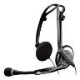
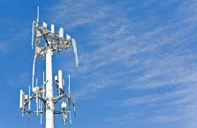
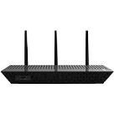

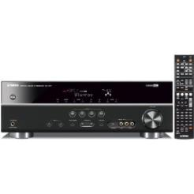

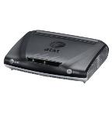
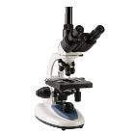

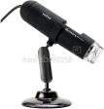
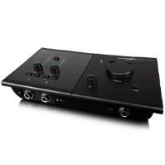
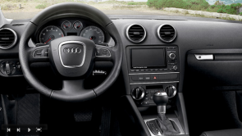


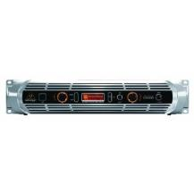
Digital Signal Processors In Products
Why this course ????
Communications
Biomedical
Wireless Wearable Multichannel EEG
Consumer audio
Microscopes
In-car entertainment
Mixing board
IP camera
Amp
MRI noise cancelling headphones
Pro-audio
Tablets
Multimedia

Slide 16
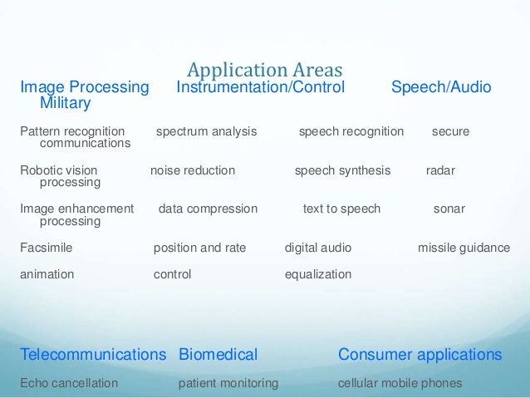

Slide 17
Typical Applications for the TMS320 DSPs
Consumer
Digital radios/TVs
Educational toys
Music synthesizers
Pagers
Power tools
Radar detectors
Solid-state answering
machines
General-Purpose
Adaptive filtering
Convolution
Correlation
Digital filtering
Fast Fourier transforms
Hilbert transforms
Waveform generation
Windowing
Automotive
Adaptive ride control
Antiskid brakes
Cellular telephones
Digital radios
Engine control
Navigation and global positioning
Vibration analysis
Voice commands
Anticollision radar

Slide 18
Embedded Processors and Systems
Embedded system works
On application-specific tasks
“Behind the scenes” (little/no direct user interaction)
Units of consumer products shipped worldwide in 2016
1495M smart phones 50M digital media streamer
270M PCs/laptops 40M DVD/Blu-ray players
175M tablets 27M game consoles
77M cars/lt trucks 23M digital still cameras
(1B+ smart phones first time in ‘14; US record 17.4M cars/lt trucks in ‘15)
How many embedded processors are in each?
How much should an embedded processor cost?
2015: iPhone6 $676 (16GB) $942 (128GB) w/o contract
5%
19%
6%
19%
15%
37%
6%
35%

Slide 19
Smart Phone Application Processors
Standalone app processors (Samsung)
Integrated baseband-app processors (Qualcomm)
iPhone5 (10+ cores)
Touchscreen: Broadcom (probably 2 ARM cores)
Apps: Samsung (2 ARM + 3 GPU cores)
Audio: Cirrus Logic (1 DSP core + 1 codec)
Wi-Fi: Broadcom
Baseband: Qualcomm
Inertial sensors: STMicroelectronics
Source: Statista and Strategy Analytics
42% Qualcomm, 18% Apple, 18% MediaTek, 22% Others.
Samsung LSI and Spreadtrum had next two largest shares.
Others: Broadcom (Avago), HiSilicon (Huawei), Intel, Marvell, Tegra (NVIDIA)
“iPhone 5 Tear Down”

Slide 20
Market for Application Processors
Tablets $ 3.6B ‘13, $ 4.2B ‘14, $ 2.7B ’15, $ 2.1B ‘16
Phones $18.0B ‘13, $20.9B ‘14, $20.1B ’15, $21.5B ’16
32% revenue of all microprocessors in 2013 (est.) [“Tablet and Cellphone Processors Offset PC MPU Weakness,” Aug 2013]
Tablet App Processor Market
Statista and Strategy Analytics
(1) Apple 37%, (2) Intel 18%,
(3) Qualcomm 16%, (4) Others 29%. MediaTek and Samsung LSI had next two largest marker shares.
HiSilicon (Huawei) performed well.
Decline in 2015 and 2016 due to strong competition from large screen smartphones

Slide 21
Signal Processing Applications
Embedded system cost & input/output rates
Low-cost, low-throughput: sound cards, 2G cell phones, MP3 players, car audio, guitar effects
Medium-cost, medium-throughput: printers, disk drives, 3G cell phones, ADSL modems, digital cameras, video conferencing
High-cost, high-throughput: high-end printers, audio mixing boards, wireless basestations, 3-D medical reconstruction from 2-D X-rays
Embedded processor requirements
Inexpensive with small area and volume
Predictable input/output (I/O) rates to/from processor
Low power (e.g. smart phone uses 200mW average for voice and 500mW for video; battery gives 5 W-hours)
Single DSP
Multiple DSP chips or cores + accelerators
Multiple multicore DSPs

Slide 22
Market share: 95% fixed-point, 5% floating-point
Each processor has dozens of configurations
Size and map of data and program memory
A/D, input/output buffers, interfaces, timers, and D/A

Slide 23

Pre-requisite :
DSP
Maths
MATLAB
Basics understanding of DSP
Convolution
Filters
Floating & Fixed point
Different functions & utilities
Discussions

Slide 24
UNIT 1: FUNDAMENTALS OF PROGRAMMABLE DSPs

Slide 25
TOPICS TO BE COVERED
Multiplier and Multiplier accumulator,
Modified Bus Structures
Memory access in P-DSPs
Multiple access memory
Multi-ported memory
VLIW architecture
Pipelining
Special Addressing modes in PDSPs
On chip Peripherals
Computational accuracy in DSP processor
Von Neumann and Harvard Architecture
Multiple Access RAM
Instruction pipelining
MAC-Convolution
Von Neumann - Harvard Architecture
Fixed-Floating nos.
Circular Buffer/Addressing

Slide 26
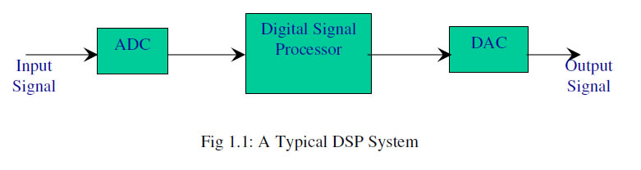
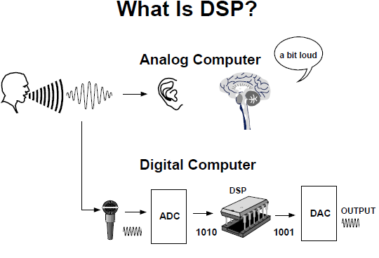
What is DSP?

Slide 27
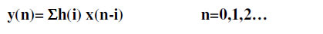
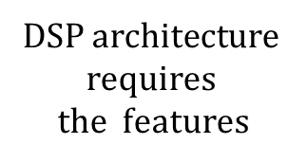
Case Study : Investigate the basic features that should be provided in the DSP architecture to be used to implement the following Nth order FIR filter
i. A RAM to store the signal samples x (n).
In order to implement the above operation in a DSP
ii. A ROM to store the filter coefficients h (n).
iii. An MAC unit to perform Multiply and Accumulate operation.
iv. An accumulator to store the result immediately.
v. A signal pointer to point the signal sample in the memory.
vi. A coefficient pointer to point the filter coefficient in the memory.
vii. A counter to keep track of the count.
viii. A shifter to shift the input samples appropriately.

Slide 28
What is Digital Signal Processors?
DSPs outperform general purpose processors for time-critical applications, and are architecturally designed for mathematical operations and data movement. (Source: www.ti.com)

Slide 29
A Digital Signal Processor, or DSP, is a semiconductor device used for processing signals digitally.
almost every piece of information has been digitized, so a digital signal may be any stream of digital data - digital audio/video data, even the weight of clothes in a washing machine etc.
Analysis of such digital signals for a variety of purposes can be easily accomplished by a DSP.
Signal processing
actions performed on signals - filtering, encoding/decoding, compression/decompression, amplification, modulation, level detection, pattern matching, mathematical/logical operations, and much more.
Reasons , why SP ? :
to enhance it;
reduce its component noise;
make its transmission and reception more effective, efficient, and faster;
make it interact with other signals in special ways;
facilitate its use in digital analysis, monitoring, or control; etc.
transform it;
A DSP has built-in capabilities to perform these signal processing functions easily.

Slide 30
DSP VS General purpose µP
A DSP is very similar to a microprocessor.
A DSP is a highly-specialized device that is equipped with
a multitude of mathematical functions specifically intended for processing a digital signal
The fundamental difference between a DSP and a microprocessor is
Both a microprocessor and a DSP can
A microprocessor would be able to handle
many different applications, such as word processing, spreadsheets, databases, and, well, even digital signal processing.
execute instructions,
accept input digital data,
perform operations on them, and
output digital data.
what their built-in processing capabilities were designed for

Slide 31
DSP processor consists of :
DSP Comput-ation
Multiplier
Shifter
Multiply & Accumulate unit
ALU
Storage
I/O interface
On chip registers
On chip RAM( s/g samples )
On chip ROM( Prog & filter coeffs.)
Peripherals

Slide 32
The Basic Features of DSPs
Feature | Use
Fast-Multiply accumulate | Most DSP algorithms, including filtering, transforms, etc. are multiplication- intensive. Have muliple function units e.g. >1 multipliers & ALUs
Multiple – access memory Architecture (Harvard ) | Many data-intensive DSP operations require reading a program instruction and multiple data items during each instruction cycle for best performance. Helps in Pipelining … a special feature of DSPs.
Specialized addressing modes | Efficient handling of data arrays and first-in, first-out buffers in memory
Specialized program control (Zero overhead loops) | Efficient control of loops for many iterative DSP algorithms. Fast interrupt handling for frequent I/O operations.
On-chip peripherals and I/O interfaces | On-chip peripherals like ADCs allow for small low cost system designs. Similarly I/O interfaces tailored for common peripherals allow clean interfaces to off-chip I/O devices.

Slide 33
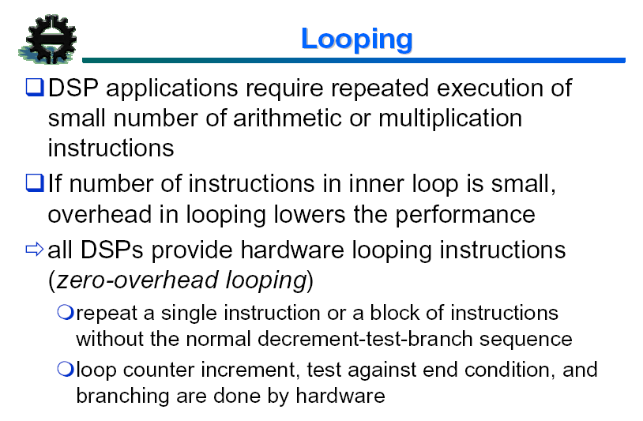

Slide 34
Hardware loops
Software loop:
MOVE #16,B Initialize loop counter B
LOOP: MAC (R0)+,(R4)+,A Register-indirect addressing with post-increment
DEC B
JNE LOOP
Hardware loops: no time is spent on
Decrementing counters
Checking to see if the loop is finished
Branching back to the top of the loop
RPT #16
MAC (R0)+,(R4)+,A

Slide 35
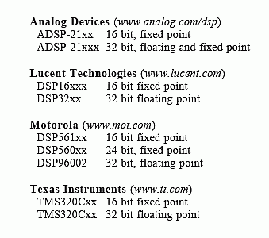
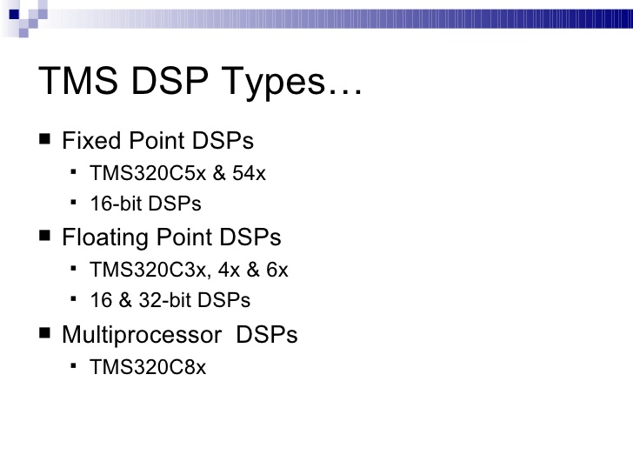
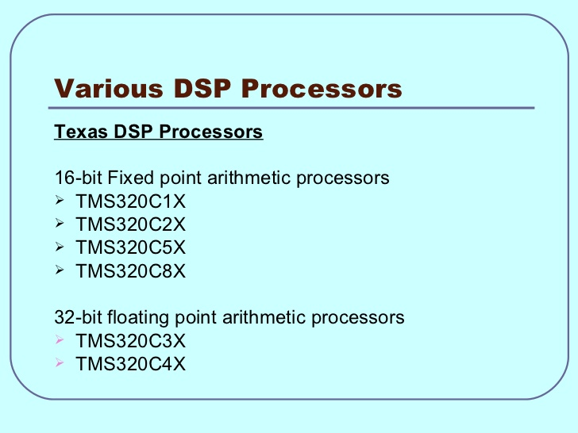

4 major companies that produce DSPs
Motorola
Lucent Technologies
Texas Instruments
Analog Devices
TMS320C5x
TMS320C54xx
TMS320C6x
Motorola DSP563xx

Slide 36
TI DSP History: Modem applications
1982 TMS32010, TI introduces its first programmable general-purpose DSP to market • Operating at 5 MIPS. • It was ideal for modems and defense applications.
1988 TMS320C3x, TI introduces the industry’s first floating-point DSP. • High-performance applications demanding floating-point performance include voice/fax mail, 3-D graphics, bar-code scanners and video conferencing audio and visual systems.
• TMS320C1x, the world’s first DSP-based hearing aid uses TI’s DSP.

Slide 37
TI DSP History: Telecommunications applications
1989 TMS320C5x, TI introduces highest performance fixed-point DSP generation in the industry, operating at 28 MIPS.
• The ‘C5x delivers 2 to 4 times the performance of any other fixed-point DSP.
• Targeted to the industrial, communications, computer and automotive segments, the ‘C5x DSPs are used mainly in
• cellular and cordless telephones,
• high-speed modems,
• printers and
• copiers.

Slide 38
TI DSP History: Automobile applications
1992 DSPs become one of the fastest growing segments within the automobile electronics market.
The math-intensive, real-time calculating capabilities of DSPs provide future solutions for
• active suspension, • closed-loop engine control systems, • intelligent cruise control radar systems, • anti-skid braking systems and • car entertainment systems.
Cadillac introduces the 1993 model Allante featuring a TI DSP-based road sensing system for a smoother ride, less roll and tighter cornering.

Slide 39
TI DSP History: Hard Disk Drive applications
1994 DSP technology enables the first uniprocessor DSP hard disc drive (HDD) from Maxtor Corp. the 171-megabyte PCMCIA Type III HDD.
• By replacing a number of microcontrollers, drive costs were cut by 30 percent while battery life was extended and storage capacity increased.
• In 1994, more than 95 percent of all high performance disk drives with a DSP inside contain a TI TMS320 DSP.
1996 TI's T320C2xLP cDSP technology enables Seagate, one of the world’s largest hard disk drive (HDD) maker, to develop the first mainstream 3.5-inch HDD to adopt a uniprocessor DSP design, integrating logic, flash memory, and a DSP core into a single unit.

Slide 40
TI DSP History: Internet applications
1999 Provides the first complete DSP-based solution, for the secure downloading of music off the Internet onto portable audio devices, with Liquid Audio Inc., the Fraunhofer Institute for Integrated Circuits and SanDisk Corp.
Announces that SANYO Electric Co., Ltd. will deliver the first Secure Digital Music Initiative (SDMI)-compliant portable digital music player based on TI's TMS320C5000 programmable DSPs and Liquid Audio's Secure Portable Player Platform (SP3).
Announces the industry's first 1.2 Volt TMS320C54x DSP that extends the battery life for applications such as cochlear implants, hearing aids and wireless and telephony devices.

Slide 41
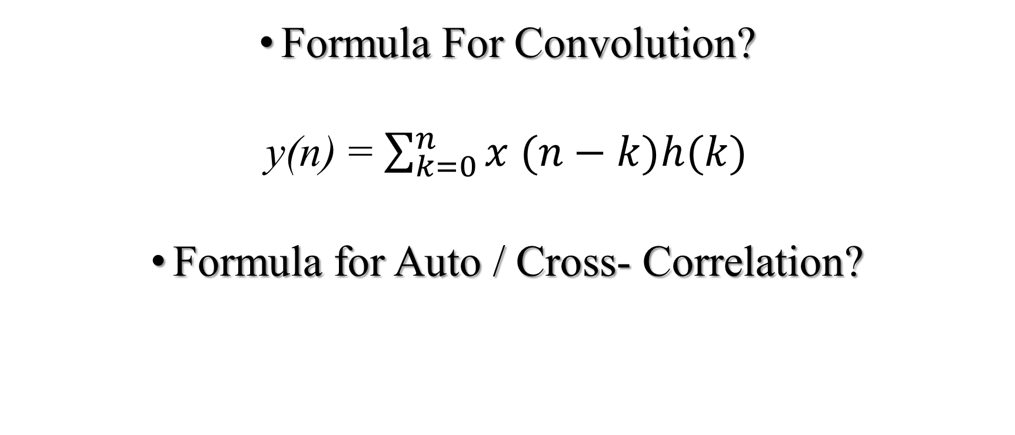
TEST
Formula For Convolution?
y(n) = $\sum_{k=0}^{n}{x (n−k)h(k)}$
Formula for Auto / Cross- Correlation?

Slide 42
Multipliers
Single chip multipliers helps for implementing DSP functions on a VLSI chip.
Parallel multipliers replaced the traditional shift and add multipliers .
Parallel multipliers take a single processor cycle to fetch and execute the instruction and to store the result. They are also called as Array multipliers.
The key features to be considered for a multiplier are: a. Accuracy b. Dynamic range c. Speed
The number of bits used to represent the operands decide the accuracy and the dynamic range of the multiplier.
Whereas speed is decided by the architecture employed. If the multipliers are implemented using hardware, the speed of execution will be very high but the circuit complexity will also increases considerably.
Thus there should be a tradeoff between the speed of execution and the circuit complexity.
Hence the choice of the architecture normally depends on the application

Slide 43
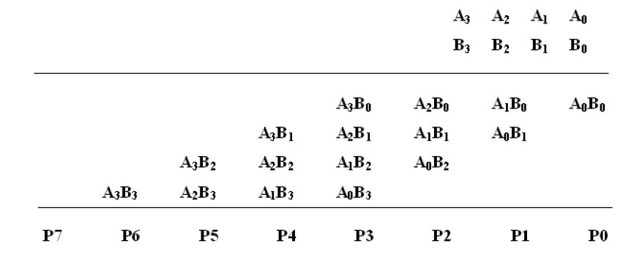
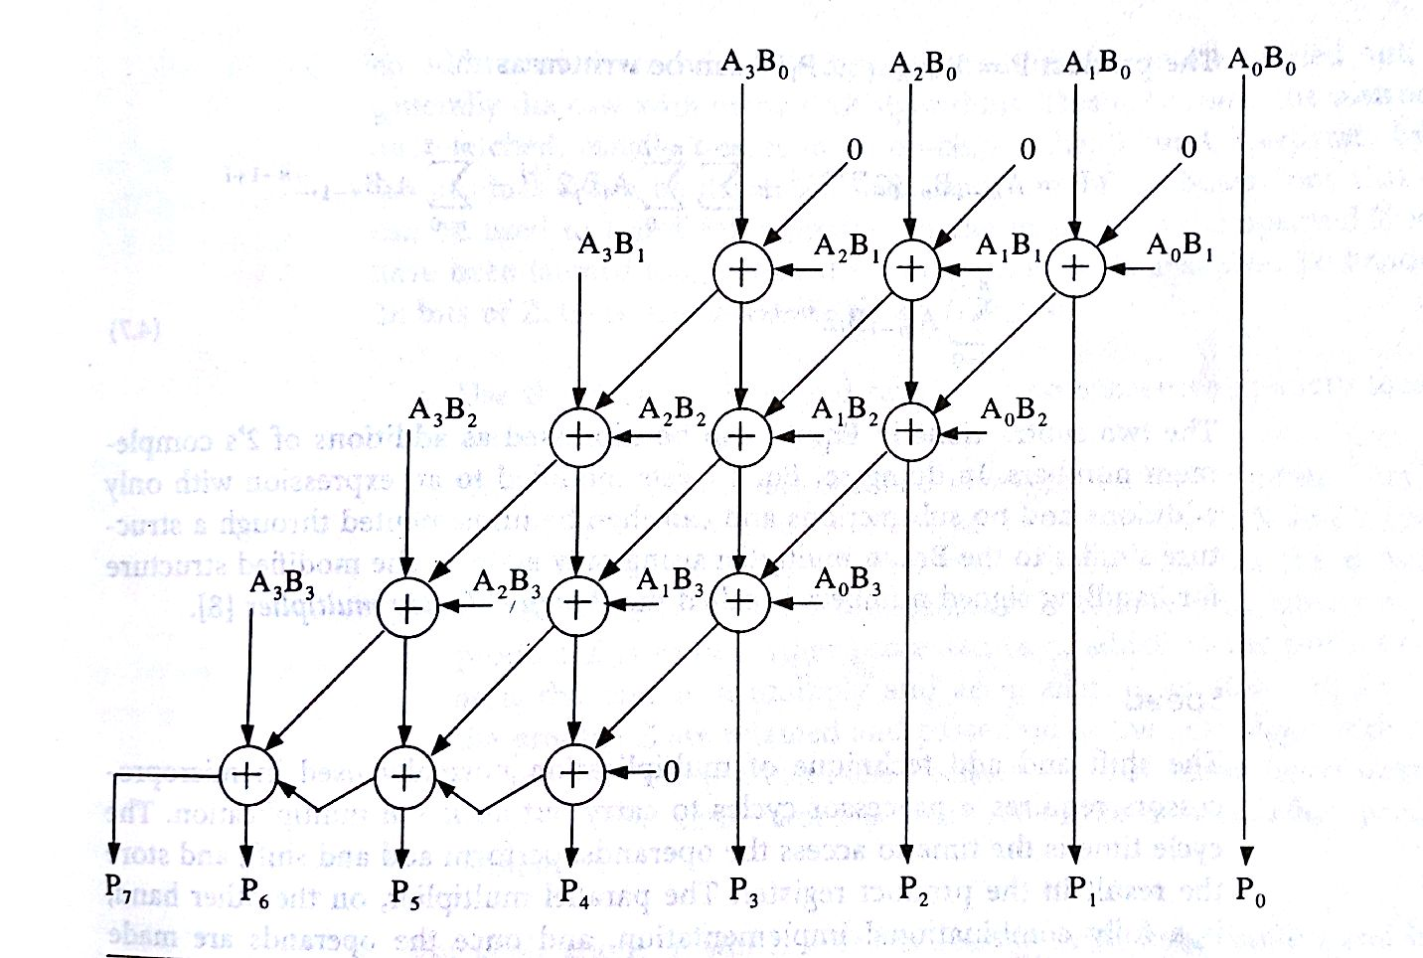
Parallel Multipliers
The multiplication of two unsigned numbers A and B
Braun multiplier for
4*4 nos.
N*N multipliers
N(N-1) Adders

Slide 44
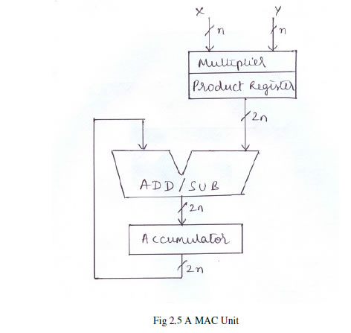
Multiply and Accumulate (MAC) unit is useful in implementing functions, such as the computation of the sum of the products of a series of successive multiplications , needed in most of the DSP applications.
A MAC consists of a multiplier and a special register called Accumulator.
MAC unit consists of a Multiplier that multiplies Two n-bit nos. X & Y, & gives product of 2n-bits width , which is added/ subtracted from the Acculator contents in the Add/ Sub unit.
Although addition and multiplication are two different operations, they can be performed in parallel.
By the time the multiplier is computing the product, accumulator can accumulate the product of the previous multiplications.
Thus if N products are to be accumulated, N-1 multiplications can overlap with N-1 additions.
During the very first multiplication, accumulator will be idle and during the last accumulation, multiplier will be idle
Thus N+1 clock cycles are required to compute the sum of N products
MAC

Slide 45
MAC
MAC: multiply & accumulator: MAC = A*B +C
Carry-save adders (csa) sums 3 numbers efficiently!
by allowing three values to be computed we can take advantage of the csa technique
Thus the MAC is not a separated multiplier and adder but a integrated singular design.
This allows easy implementation of y[n] = Σ c[k] * x[n-k]
Hence, less area and faster than a separate multiplier andadder.

Slide 46
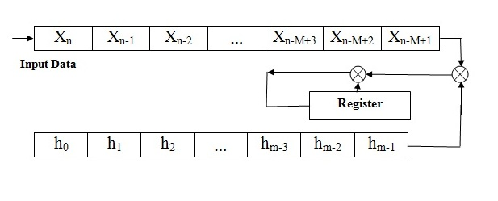
MUTIPLIER & MUTIPLIER ACCUMULATOR (MAC)….
₊
Fig: 1 Implementation of Convolver with Single Multiplier / adder

Slide 47
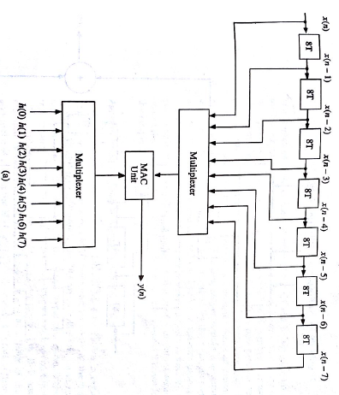
Implementation of Convolver( FIR)
Using single MAC unit

Slide 48
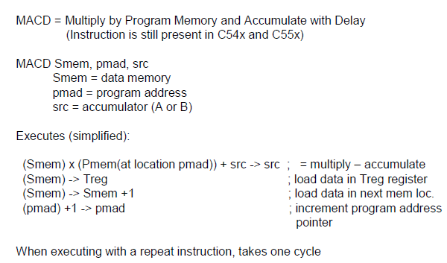

Slide 49
Multiple Access Memory
The number of memory accesses/clock period can be increased by using a high speed memory , than one memory accesses/clock period , which permits more than one memory accesses per clock cycle
Dual Access RAM ( DARAM ) permits 2 memory accesses /clock period
Multiple access RAM can be connected to the processing unit of the P-DSP by using Harvard architecture.
e.g. DARAM connected to a P-DSP with 2 independent Data & Address buses can be used to achieve 4 memory accesses per clock period.

Slide 50
Data/Program Dual-Access RAM
The DARAM is divided into three individually selectable memory blocks: data or program DARAM block B0, word data DARAM block B1, and data DARAM block B2.
The DARAM is primarily intended to store data values but, when needed, can be used to store programs as well.
DARAM blocks B1 and B2 are always configured as data memory; however, DARAM block B0 can be configured by software as data or program memory. The DARAM can be configured in one of two ways:
1) All words 16 bits configured as data memory
2) Few words 16 bits configured as data memory and Few words 16 bits configured as program memory
DARAM improves the operational speed of the CPU.
The CPU operates with a pipeline where the CPU reads data ( say in 4-pipeline structure ) on the third stage and writes data on the fourth stage.
Hence, for a given instruction sequence, the second instruction could be reading data at the same time the first instruction is writing data.
The dual data buses (DB and DAB) allow the CPU to read from and write to DARAM in the same m/c cycle.

Slide 51
Multiported Memory
Address Bus1
Data Bus 1
Dual port
memory
Address Bus 2
Data Bus 2
Fig: Block Diagram of a dualported memory

Slide 52
Very Long Instruction Word (VLIW)
A technique for instruction-level parallelism by executing instructions without dependencies (known at compile-time) in parallel
Example of a single VLIW instruction:
F=a+b;
c=e/g;
d=x&y;
w=z*h;

Slide 53
VLIW (Very Long Instruction Word ) Architecture
PROGRAM CONTROL UNIT
Multiported register file
Read/Write cross bar
Functional
Unit 1
Functional
Unit n
. . . . .
Fig: Block Diagram of the VLIW Architecture
Instruction cache

Slide 54
Pipelining
One of the approach for increasing the efficiency of P-DSPs and Advanced Microprocessors.
An instruction cycle starting with the fetching of an instruction & ending with the execution of the instruction including the time storage of the results can be split into a number of microinstructions.

Slide 55
Approach
An instruction cycle requiring four microinstructions can be said to be in four phases as follows:
1) Fetch Phase
2) Decode Phase
3) Memory read Phase
4) Execution Phase
Each of the above microinstructions may be carried out separately by four functional units.

Slide 56
Pipelining: Its Natural!
e.g. Laundry Example
A, B, C, D each have one load of clothes to wash, dry, and fold
Washer takes 30 minutes
Dryer takes 40 minutes
“Folder” takes 20 minutes
A
B
C
D

Slide 57
Sequential Laundry
6 PM
7
8
9
10
11
Midnight
Time
Value of T | Fetch | Decode | Read | Execute
1 | I1
2 |  | I1
3 |  |  | I1
4 |  |  |  | I1
5 | I2
6 |  | I2
7 |  |  | I2
8 |  |  |  | I2
9 | I3
10 |  | I3
11 |  |  | I3
12 |  |  |  | I3
30
40
20
30
40
20
30
40
20
30
40
20
T
a
s
k
O
r
d
e
r
A
B
C
D
Sequential laundry takes 6 hours for 4 loads
If used pipelining, how long would laundry take?

Slide 58
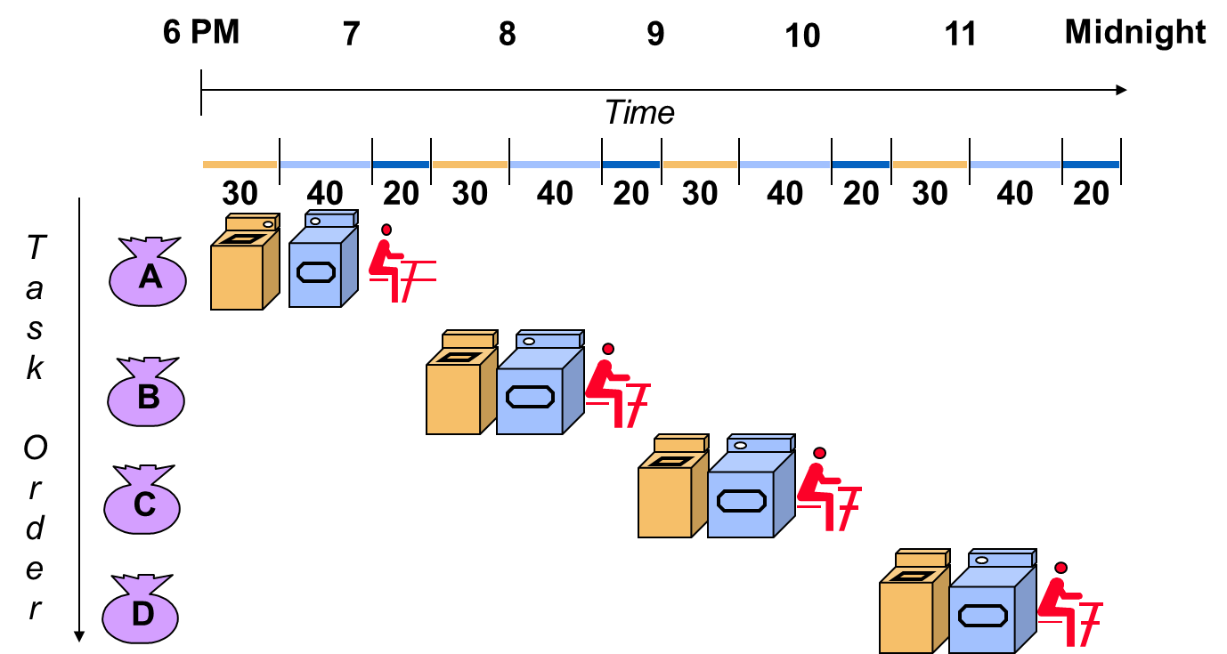
Fig: Instruction cycles of processor with no pipelining
Value of T | Fetch | Decode | Read | Execute
1
2
3
4
5
6
7
8
9
10
11
12
I1
I1
I1
I1
I2
I2
I2
I2
I3
 | I3
 |  | I3
 |  |  | I3

Slide 59
Pipelined Laundry
6 PM
7
8
9
10
11
Time
Midnight
30
40
40
40
40
20
T
a
s
k
O
r
d
e
r
A
B
C
D
Pipelined laundry takes 3.5 hours for 4 loads

Slide 60
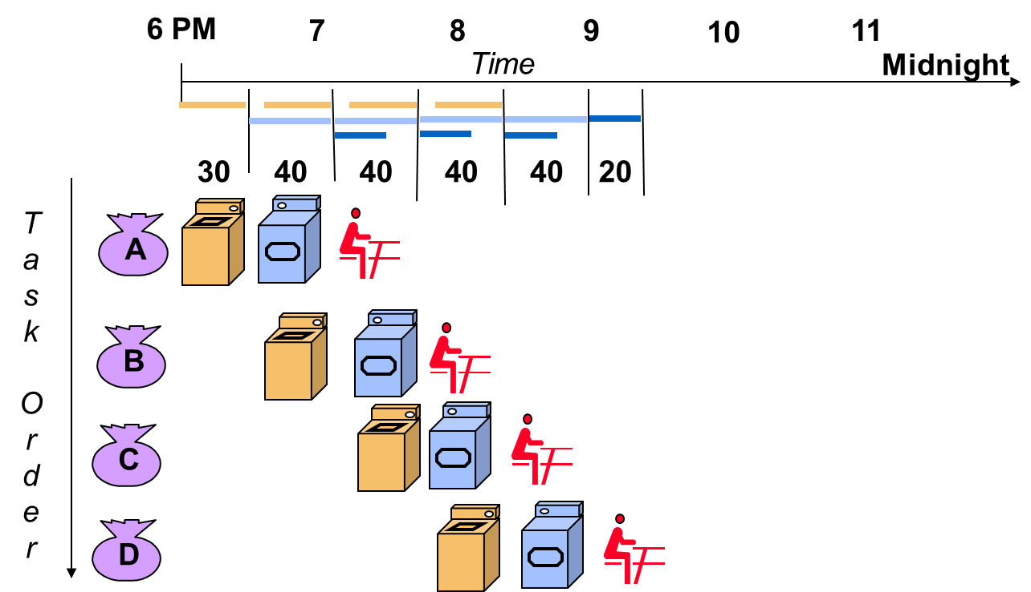
Fig: Instruction cycles of processor with pipelining
Value of T
1
2
3
4
5
6
7
8
9
10
11
12
Fetch | Decode | Read | Execute
1 | I1
I2
2 |  | I1
3 |  |  | I1
4 |  |  |  | I1
I3
I2
I4
I3
I2
I5
I4
I3
I2
I6
I5
I4
I3
I7
I6
I5
I4
I8
I7
I6
I5
I9
I8
I7
I6
I9
I8
I7
I9
I8
I9

Slide 61
Pipelining
Fig: Instruction cycles of processor with no pipelining
Fig: Instruction cycles of processor with pipelining
Value of T | Fetch | Decode | Read | Execute
1 | I1
2 |  | I1
3 |  |  | I1
4 |  |  |  | I1
5 | I2
6 |  | I2
7 |  |  | I2
8 |  |  |  | I2
9 | I3
10 |  | I3
11 |  |  | I3
12 |  |  |  | I3
Value of T | Fetch | Decode | Read | Execute
1 | I1
2 | I2 | I1
3 | I3 | I2 | I1
4 | I4 | I3 | I2 | I1
5 | I5 | I4 | I3 | I2
6 | I6 | I5 | I4 | I3
7 | I7 | I6 | I5 | I4
8 | I8 | I7 | I6 | I5
9 | I9 | I8 | I7 | I6
10 |  | I9 | I8 | I7
11 |  |  | I9 | I8
12 |  |  |  | I9

Slide 62
Pipelining Lessons
Pipelining doesn’t help latency of single task, it helps throughput of entire workload
Pipeline rate limited by slowest pipeline stage
Multiple tasks operating simultaneously
Potential speedup = Number of pipeline stages
Unbalanced lengths of pipe stages reduces speedup
Time to “fill” pipeline and time to “drain” it reduces speedup

Slide 63
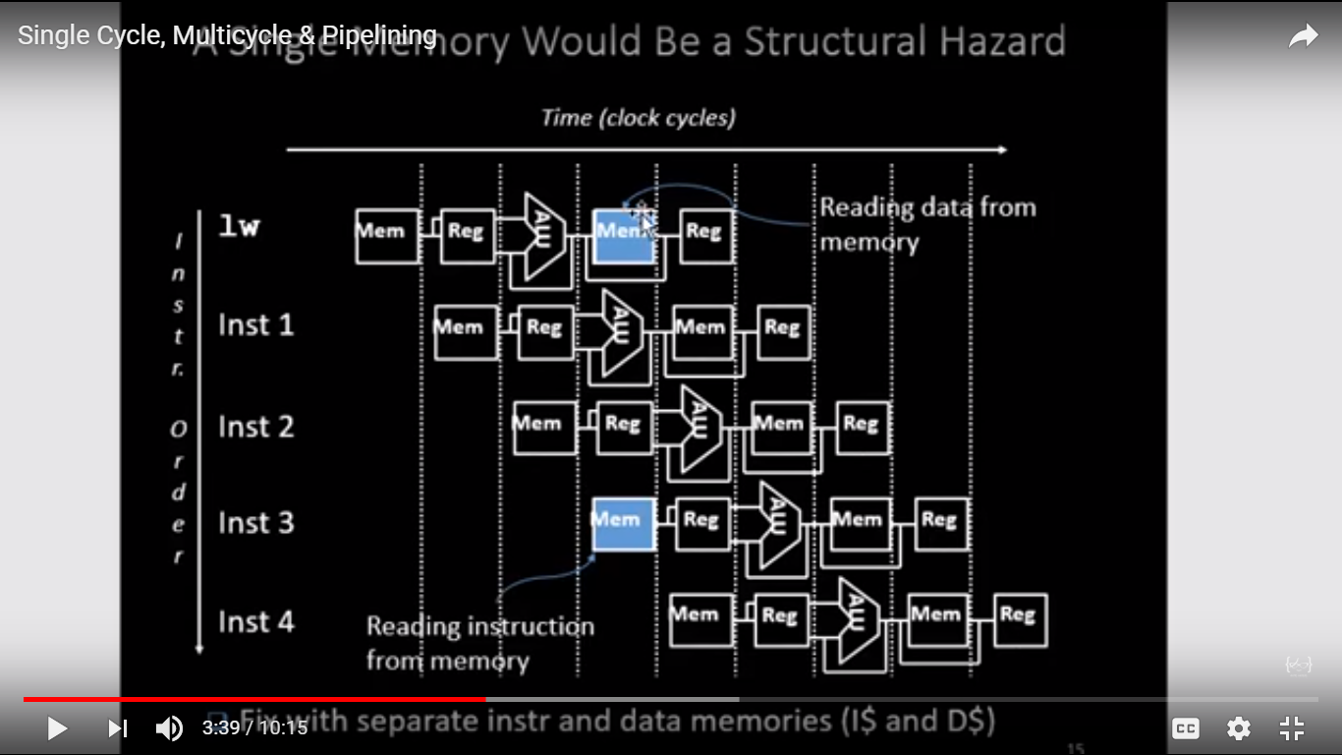

Slide 64
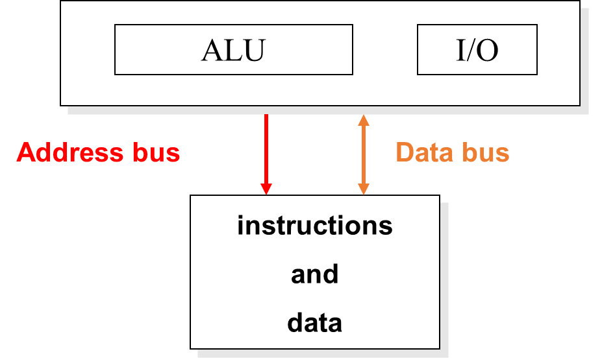
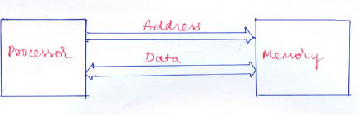
Von Neuman Architecture
Results
Processing Unit
Data Bus
Operands
Status
Opcode
Instructions
Data/ Instructions
Control Unit
Data & Program memory
Address

Slide 65
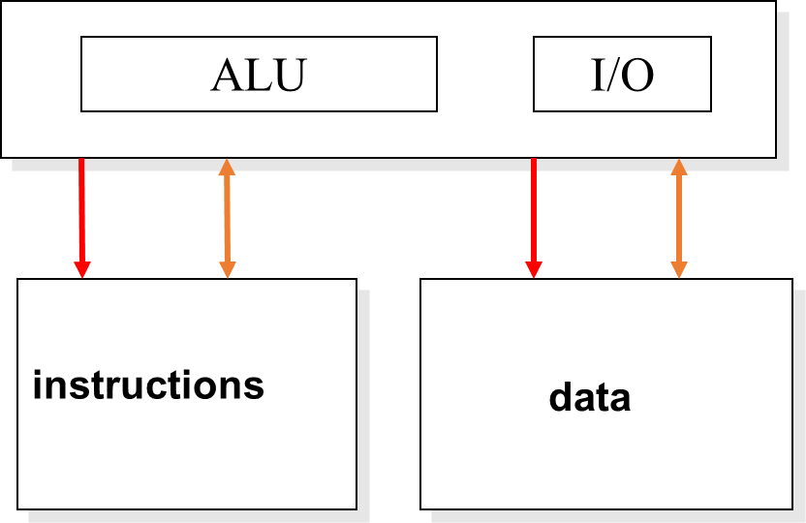
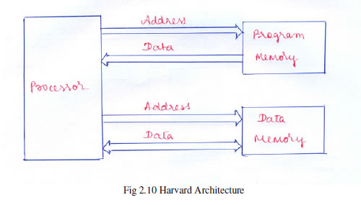
Harvard Architecture
Results / Operands
Data Memory
Processing Unit
Status
Opcode
Address
Control Unit
Program Memory
Instructions
Address

Slide 66
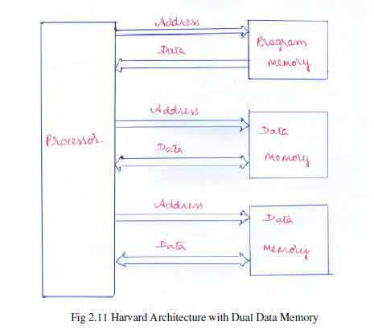
Modified Harvard Architecture
Results / Operands
Data Memory
Processing Unit
Status
Opcode
Address
Control Unit
Instructions
Program Memory
Address

Slide 67
Special Addressing Modes in P-DSPs
1) Short Immediate Addressing
2) Short direct Addressing
3) Memory-mapped Addressing
4) Indirect Addressing
5) Bit Reversed Addressing Mode
6) Circular Addressing

Slide 68
1) Short Immediate Addressing
Permits the operand to be specified using a short constant that forms part of a single word instruction.
The length of the short constant depends on the instruction type & P-DSP.
Short immediate values can be 3, 5, 8, or 9 bits in length.

Slide 69
2) Short direct Addressing
Permits the lower order address of the operand of an instruction to be specified in the single word instruction.
In TI TMS320 DSPs, the higher order 9 bits of the memory are stored in the data page pointer & only the lower 7 bits are specified as a part of the instruction.

Slide 70
Generation of Data Addresses in Direct Addressing Mode

Slide 71
Some Info. about DP
In the direct addressing mode, data memory is addressed in blocks of 128 words called data pages.
The entire 64K of data memory consists of 512 data pages labeled 0 through 511, as shown in Fig.
The current data page is determined by the value in the 9-bit data page pointer (DP) in status register ST0.
For example, if the DP value is (0 0000 0000)₂, the current data page is 0. If the DP value is (0 0000 0010)₂, the current data page is 2.

Slide 72
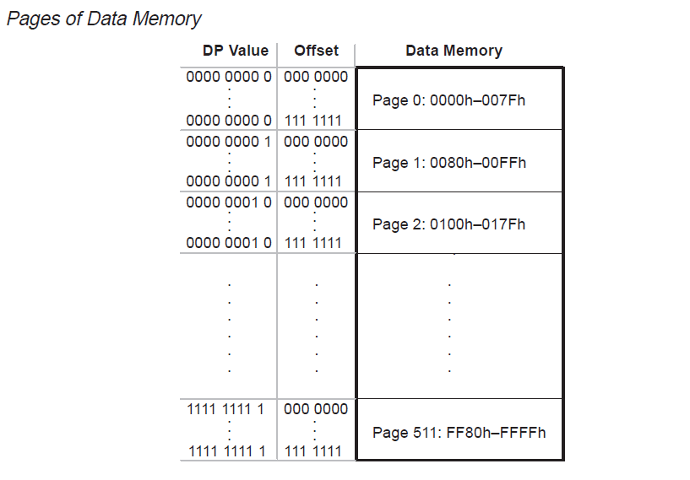

Slide 73
3) Memory-mapped Addressing
The CPU registers & I/O registers of P-DSPs are also accessible as memory location.
This is achieved by storing them in either the starting page or the final page of the memory space.
For Eg. In TMS320C5X, page 0 corresponds to CPU registers & I/O registers.
When these registers are accessed using memory mapped addressing modes, the higher address bits are not taken from the data page pointer & instead made to be 0 in case of TI DSPs & 1 in Motorola DSPs.

Slide 74
4) Indirect Addressing
In indirect addressing, any location in the 64K-word data space can be accessed using the 16-bit address contained in an auxiliary register.
The address can be stored in one of the registers called indirect address registers.
The C54x DSP has eight 16-bit auxiliary registers (AR0–AR7).
Indirect addressing is used mainly when there is a need to step through sequential locations in memory in fixed-size steps.
Any of these registers can be updated when the operand fetched using these registers are being executed.
This is made possible by having an additional ALU in CPU core.

Slide 75
4) Indirect Addressing
The ARs can be incremented or decremented either in steps of 1 or in steps specified by the content of an offset register.
In TI, offset register is called as INDX register.
In Analog devices, called as Modifier Register.
Contents can also be updated by a constant using Bit Reversed Addressing Mode.
In TI C54X, Pre-increment / decrement & Post-increment / decrement is supported.

Slide 76
5) Bit Reversed Addressing Mode
The binary pattern corresponding to a particular decimal number is obtained by writing the natural binary equivalent of the number in the reverse order so that the MSB of the natural binary becomes the LSB of the bit reversed number & vice-versa.

Slide 77
Decimal Number | Natural Binary Number | Bit Reversed Number
0 | 0000 | 0000
1 | 0001 | 1000
2 | 0010 | 0100
3 | 0011 | 1100
4 | 0100 | 0010
5 | 0101 | 1010
6 | 0110 | 0110
7 | 0111 | 1110
8 | 1000 | 0001
9 | 1001 | 1001
10 | 1010 | 0101
11 | 1011 | 1101
12 | 1100 | 0011
13 | 1101 | 1011
14 | 1110 | 0111
15 | 1111 | 1111

Slide 78
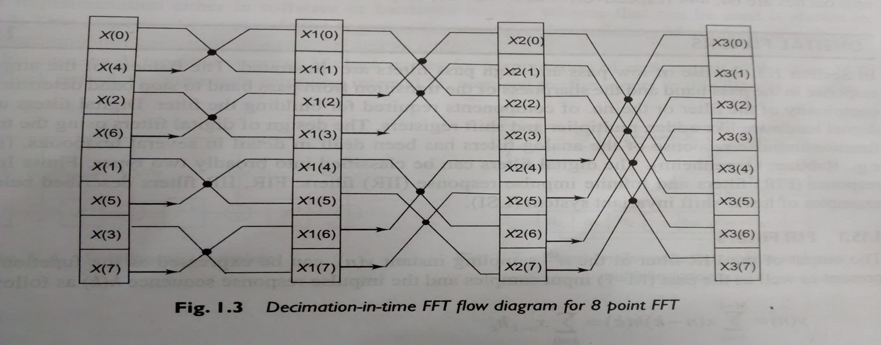
DIT FFT Flow Diagram

Slide 79
6) Circular Addressing
Memory can be organized as a circular buffer with the beginning memory address & the ending memory address corresponding to this buffer defined by the programmer.
In this, when the address pointer is incremented, the address will be checked with the ending memory address of the circular buffer.
If it exceeds that, the address will be made equal to the beginning address of the circular buffer.

Slide 80
Pointer updating Algorithm for Circular Addressing mode :
Updated PNTR = PNTR+/- increment
IF SAR < EAR & Updated PNTR > EAR then
New PNTR = Updated PNTR – Buffer Size
& IF Updated PNTR < SAR then,
New PNTR = Updated PNTR + Buffer Size
IF SAR > EAR & Updated PNTR > SAR then
New PNTR = Updated PNTR – Buffer size
& IF Updated PNTR < EAR then,
New PNTR = Updated PNTR + Buffer Size
Else New PNTR = Updated PNTR
Buffer Size =
EAR-SAR +1
Buffer Size =
SAR- EAR +1
A DSP has a circular buffer with the start and the end addresses as 0200 h and 020F h respectively. What would be the new value of the address pointer of the buffer if in the course of address computations, it gets updated to a) 0212 h b) 01FC h.
Buffer Size =EAR- SAR +1 = 020F-0200+1 =10 h
a) New PNTR = Updated PNTR – Buffer Size=0212-0010=0202h
b) New PNTR = Updated PNTR + Buffer Size=01FC+0010=020Ch

Slide 81
On Chip Peripherals
1) On-chip Timer
2) Serial Port
3) TDM Serial port
4) Parallel Port
5) Bit I/O Ports
6) Host Port
7) Comm Ports
8) On-Chip A/D and D/A Converters
9) P-DSPs with RISC & CISC

Slide 82
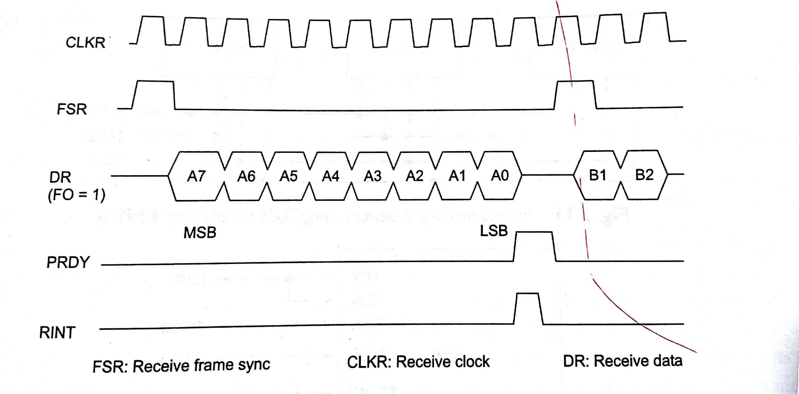
2) Serial Port
Fig: Burst Mode Serial Port Receive Operation

Slide 83
3) TDM Serial port
Ch1 | Ch2 | Ch3 | Ch4 | Ch5 | Ch6 | Ch7 | Ch8
One TDM Frame
Fig: TDM Frame with 8 time slots

Slide 84
3) TDM Serial port
TFRM: The Frame Sync Signal
TClock: The Bit Clock
TADD: The Address of the serial device that is outputting data in a particular TDM Slot.
TDAT: The data transmitted into the TDM channel by authorized device.

Slide 85
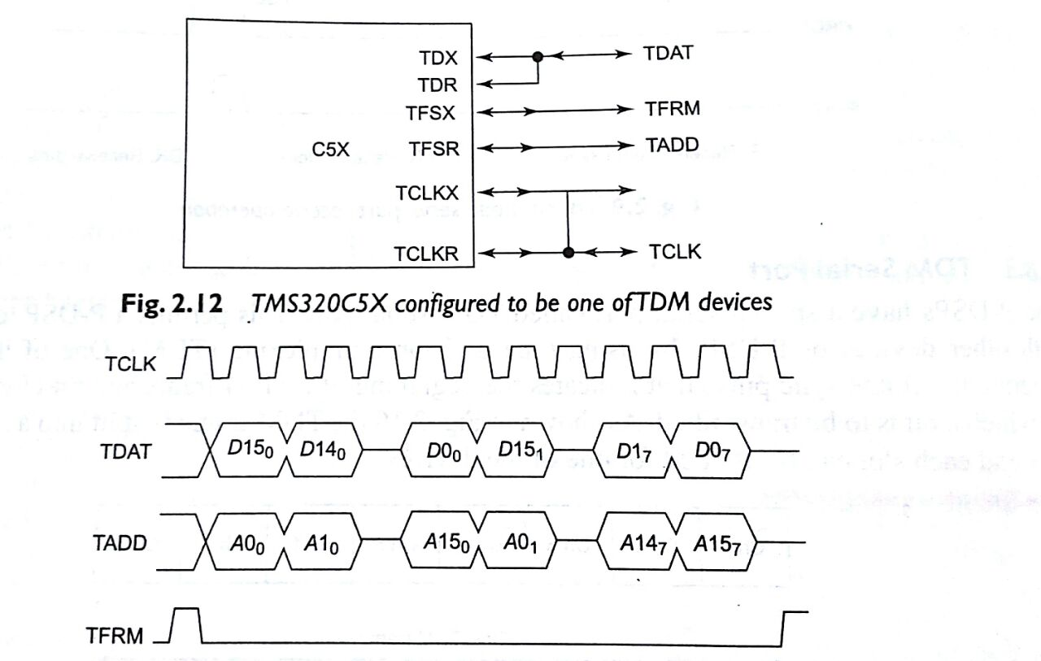
Fig. Data transfer using TDM Channel

Slide 86
9) P-DSPs with RISC & CISC
TI TMS320C6X P-DSPs uses RISC processor.
Large number of Analog Devices & Motorola Devices uses CISC.

Slide 87
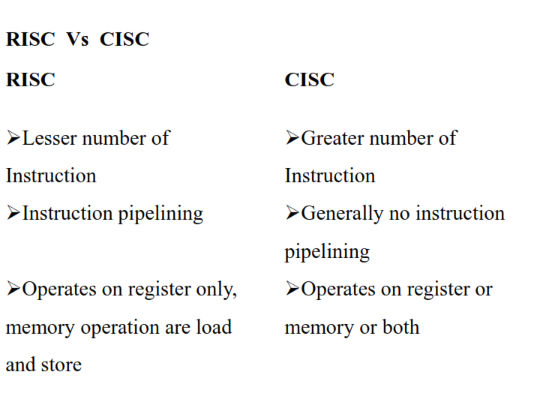

Slide 88
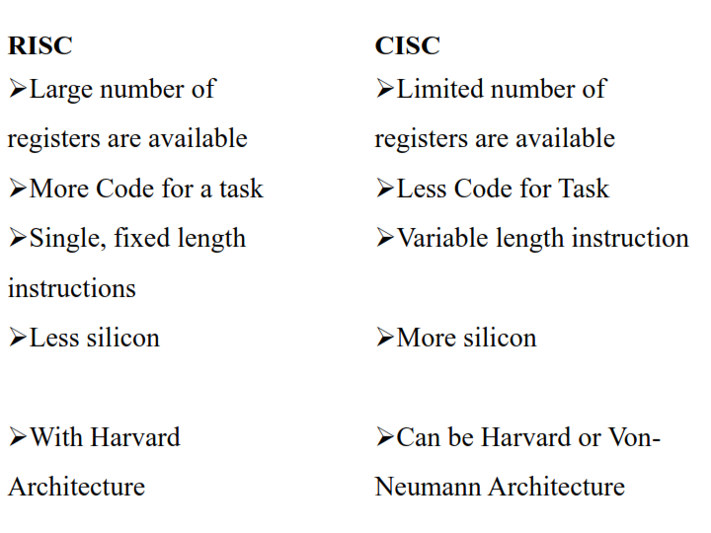

Slide 89
References
Unit shipments worldwide
Blu-ray & DVD players: https://www.futuresource-consulting.com/reports/report/r/futuresource-worldwide-home-video-market-report/i/412362
Cars & light trucks: http://www.gbm.scotiabank.com/scpt/gbm/scotiaeconomics63/GAR_2017-02-07.pdf
Digital media streamers: https://www.strategyanalytics.com/access-services/devices/connected-home/consumer-electronics/reports/report-detail/global-connected-tv-device-vendor-share-q3-2016
Digital still cameras: http://promuser.com/markets/2017/global-digital-camera-market-report-january-2017
iPhone5: http://www.ifixit.com/Teardown/iPhone-5-Teardown/10525/
PCs/laptops: https://www.gartner.com/newsroom/id/3568420
Smart phones: http://www.gartner.com/newsroom/id/3609817
Tablets: https://www.idc.com/getdoc.jsp?containerId=prUS42272117
Video game consoles: https://www.statista.com/statistics/276768/global-unit-sales-of-video-game-consoles/
Embedded processor resources
Embedded Microproc. Benchmark Consortium: http://www.eembc.org
Embedded processing comparison: http://www.embeddedinsights.com/directory.php

